Slide 1
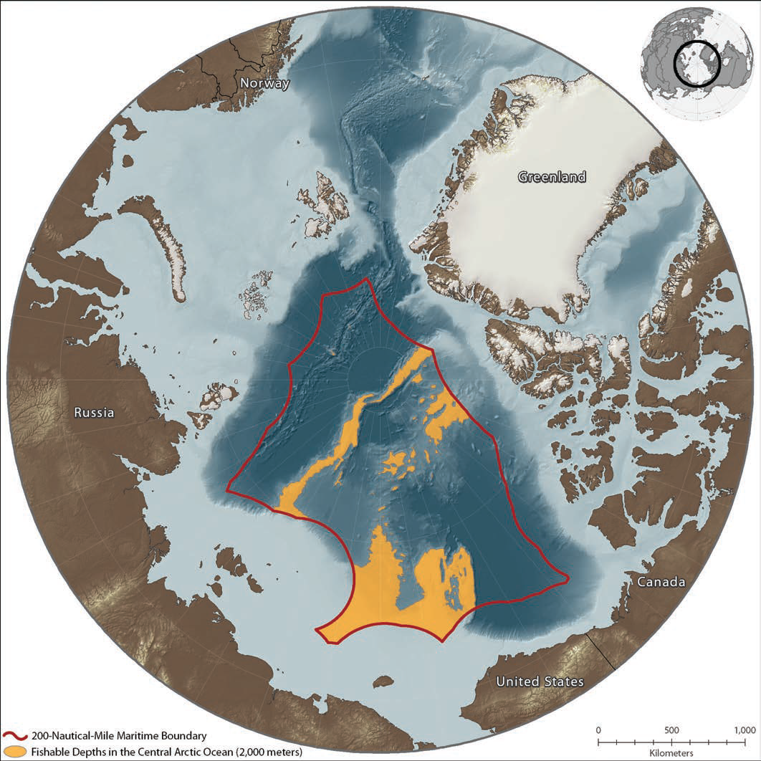
US Contribution to SAS: Planning Stage May 2019
Jackie Grebmeier, Chesapeake Biological Laboratory/UMCES, Solomons, MD, USA
SAS will have multiple transects into the basin in 2020-2021 as a pan-Arctic effort to better understand the status and trends in physical drivers, the carbon components, and ecosystem response
Ecosystem pelagic & benthic components, possibly including paired trawls and acoustics for fisheries (ship dependent)
Planning underway for pilot NOAA effort on USCGC Healy as extension to the Distributed Biological Observatory-Northern Chukchi Sea Integrated Study (DBO-NCIS) 2020 effort
SAS needs to be multi-agency, perhaps as an Interagency Arctic Research Policy “Flagship” effort; also private funding
Fishable depths were derived from IBCAO v3 bathymetry (www.ngdc.noaa.gov/mgg/bathymetry/arctic/).
Pacific Arctic Region
Twenty-two percent of the Central Arctic Ocean (CAO)is made up of ridges and continental shelves at fishable depths of 2,000 meters or less
International waters of CAO north of 200 nm Exclusive Economic Zones (EEZs)

Slide 2
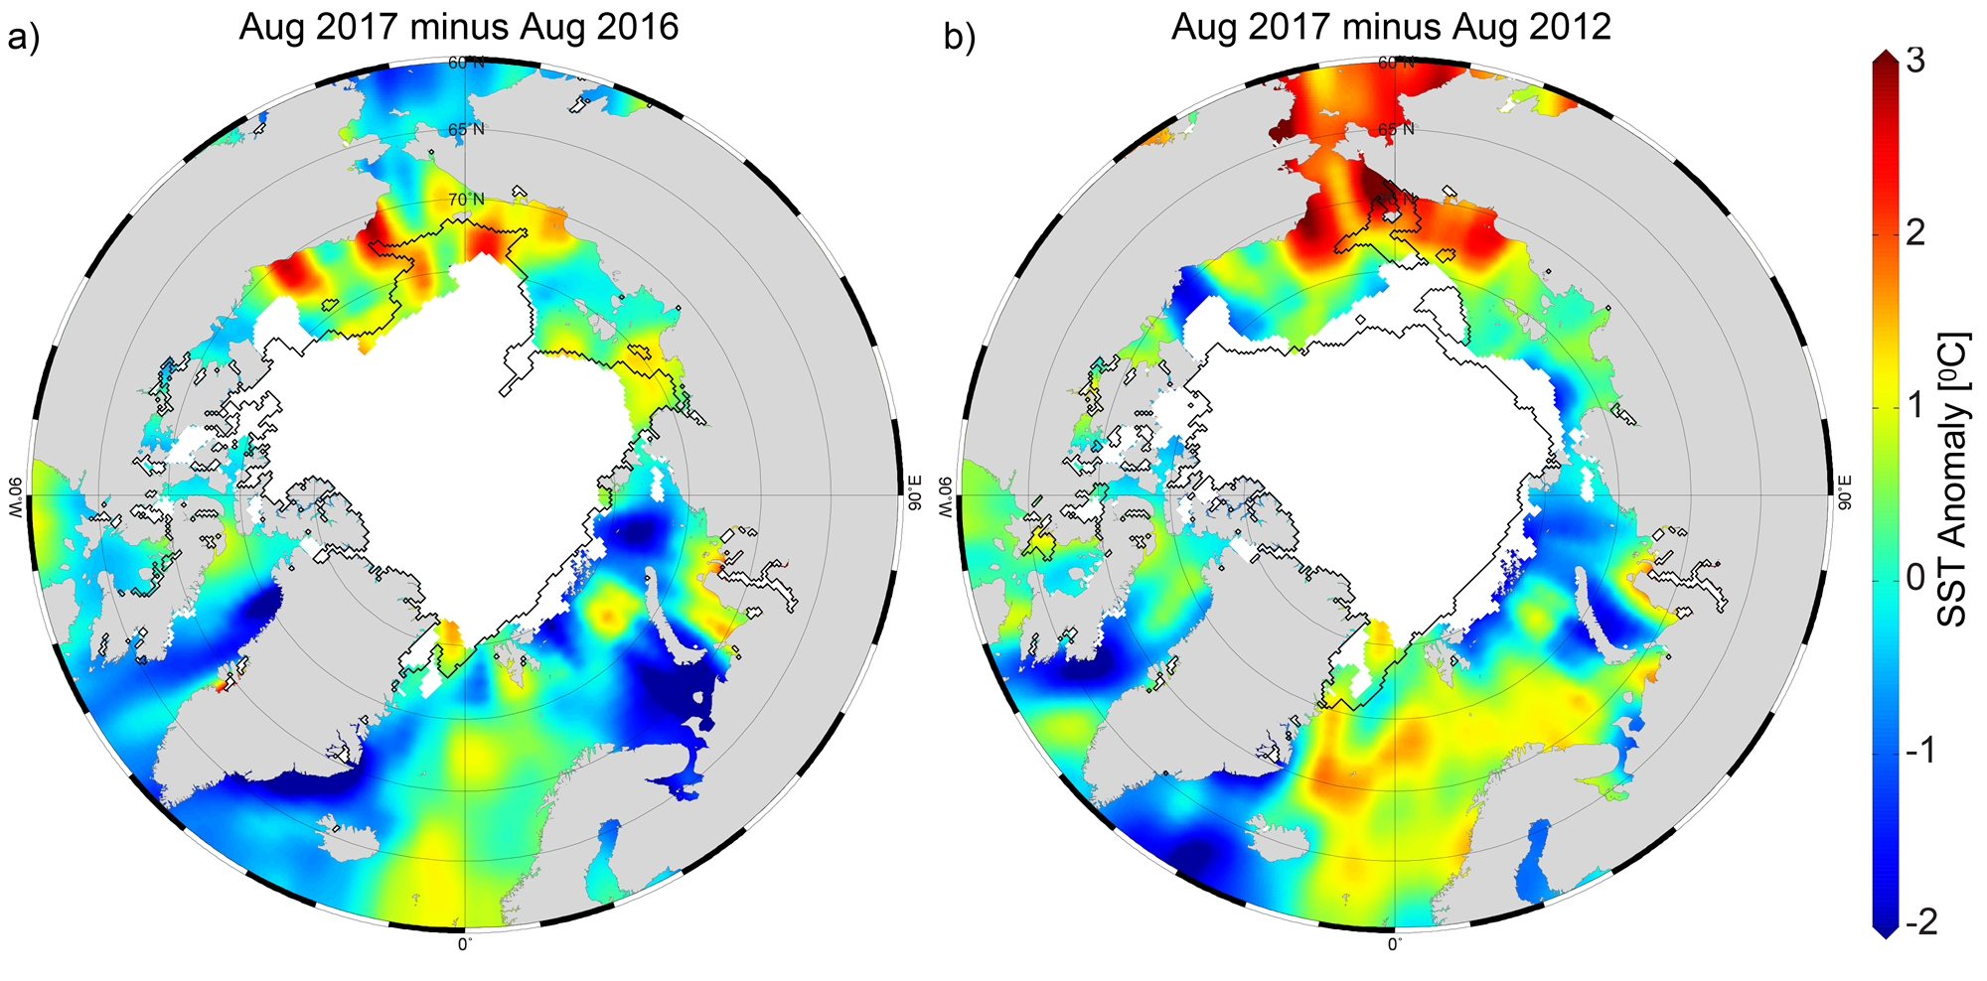
Arctic Ocean Sea Surface Temperature Change
Chukchi Sea
[Timmermans et al. 2017]

Slide 3
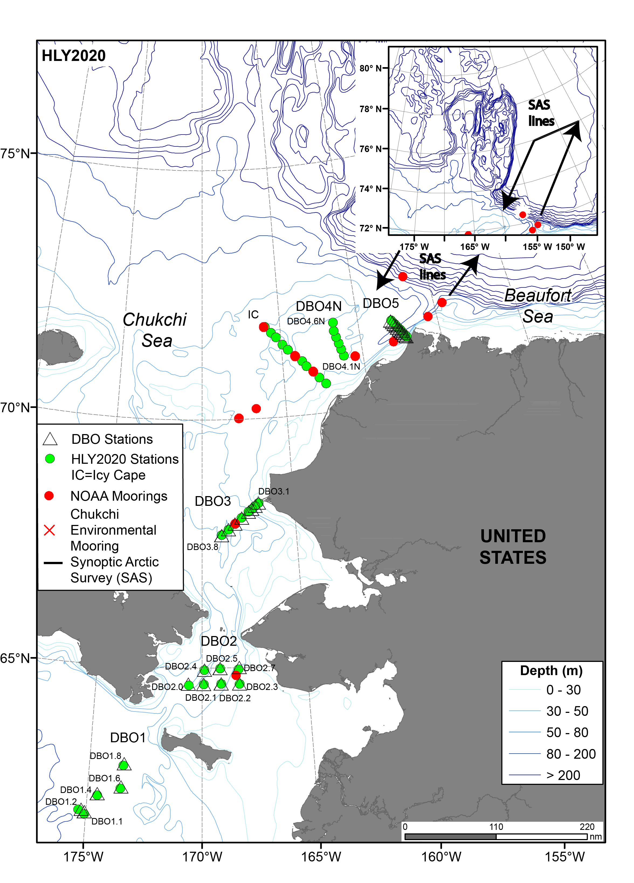
Developing US NOAA Contribution to the
Synoptic Arctic Survey (SAS) in 2020
Part 1 - Distributed Biological Observatory (DBO)-Northern Chukchi Integrate Study (NCIS)
Part 2- Synoptic Arctic Survey
Two transect lines in/out CAO
Standard SAS measurements
Extend from Chukchi slope into Canada Basin
Reoccupy SBI Barrow Canyon line outbound into CAO
Return on SBI East Hanna Shoal line for temporal comparison, along with data from Geotracers and other international programs
SBI=Western Arctic Shelf-Basin Interactions, 2002-2004

