Slide 1
Canadian Contribution to SAS
Kumiko Azetsu-Scott
Fisheries and Oceans, Canada
Bedford Institute of Oceanography
Bill Williams
Fisheries and Oceans, Canada
Institute of Ocean Sciences
Jean-Eric Tremblay
Universite Laval
SAS workshop, WHOI, May 2019

Slide 2
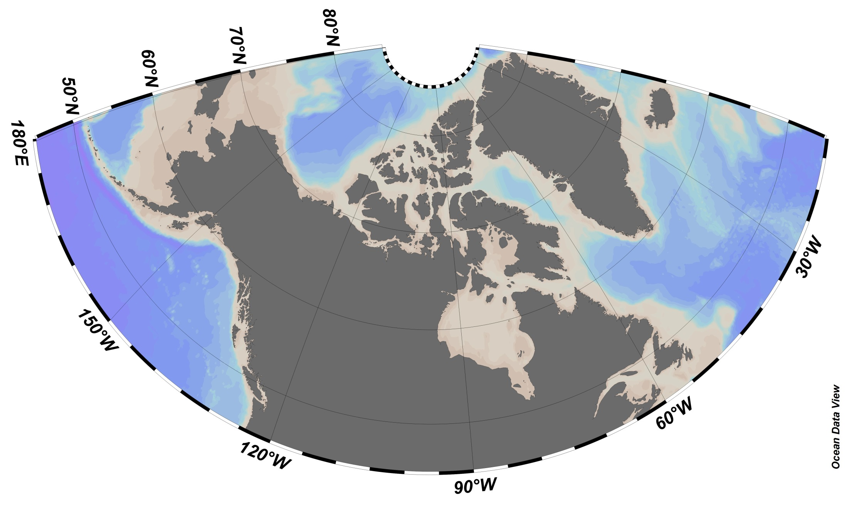
JOIS-BGOS and Davis Strait Observing System
Davis Strait
(Canada, US, EU)
Moorings, DIC, TA, nutrients, O2, pCO2, CFC-12/SF6, O-18, biology
JOIS/AON-BGOS
(Canada, US, Japan)
Moorings, DIC, TA, nutrients, O2, some transient tracers, O-18, Ba, biology
CBS-MEA, BS Coastal
ArcticNet
Hydrography, BGC-Argo, Natural,+social sciences, human health
DFO’s Arctic Real Time Ocean Observatory (Barrow Strait)
T, S, ice, biology
BaySYS - Hudson Bay

Slide 3
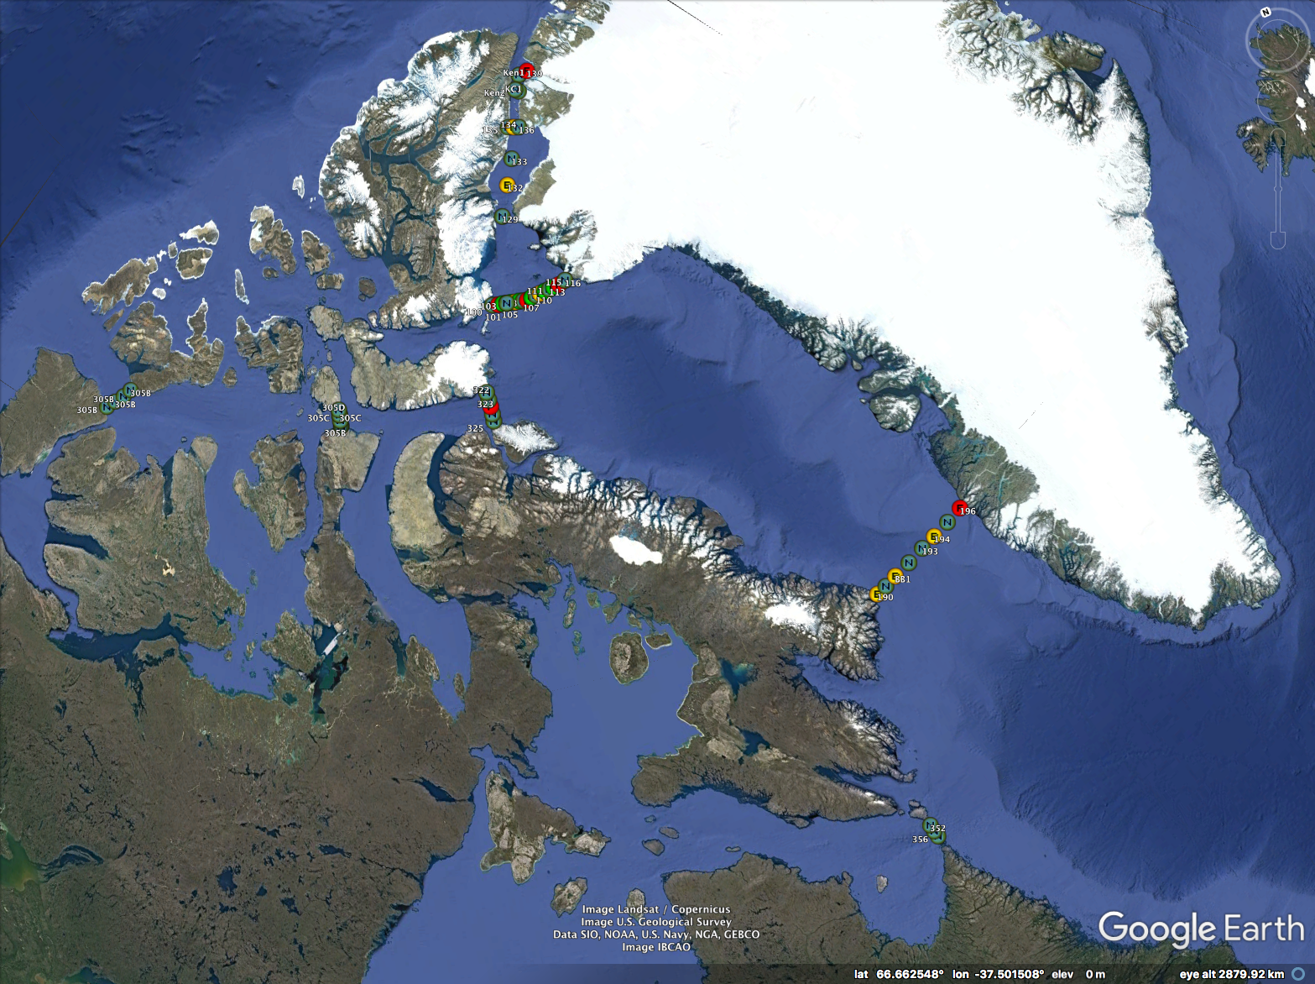
NTRAIN
Nutrient Transports and
living marine Resources
Across the Inuit Nunangat
2021?
2019-2022
(ArcticNet 2.0)
Qikiqtarjuaq
Core sections
Ice-dependent sections
Community-based sampling
Quaqtaq

