Slide 1
Country report: Russia sampling results from kara, laptev, east-Siberian seas
Alexander Polukhin
Shirshov Institute of Oceanology, Russian Academy of Sciences
polukhin@ocean.ru

Slide 2
Research crusises to the kara sea by sio ras
Sampling data
CTD
Chemistry in water (nutrients, carbonate system parameters, oxygen isotopes)
Biology (primary production, chlorophyll a, phyto- and zooplankton, benthos)
Chemistry in porewater and sediments (nutrients, carbonate system)

Slide 3
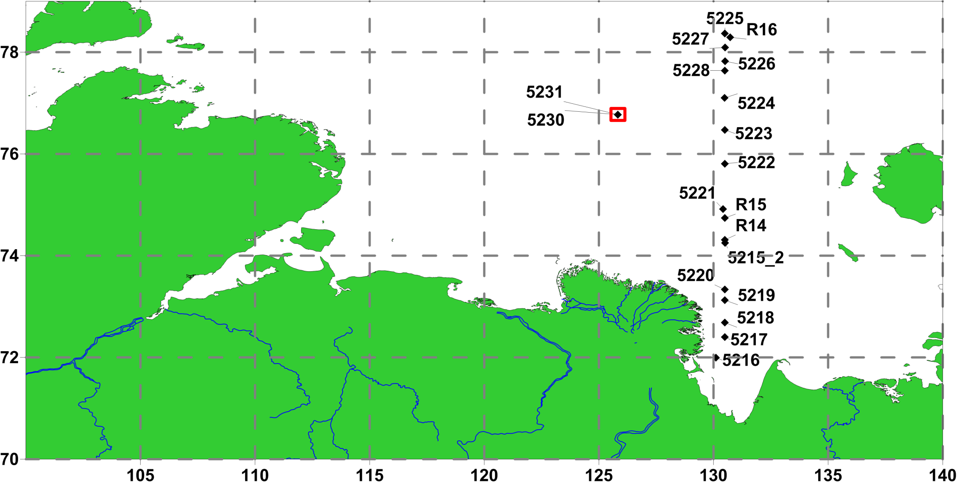
Laptev Sea 2015, September

Slide 4
25.08-29.09.2017

Slide 5
19.08-16.09.2018

Slide 6
Russian research institutes expeditions to the arctic in 2017

