Slide 1
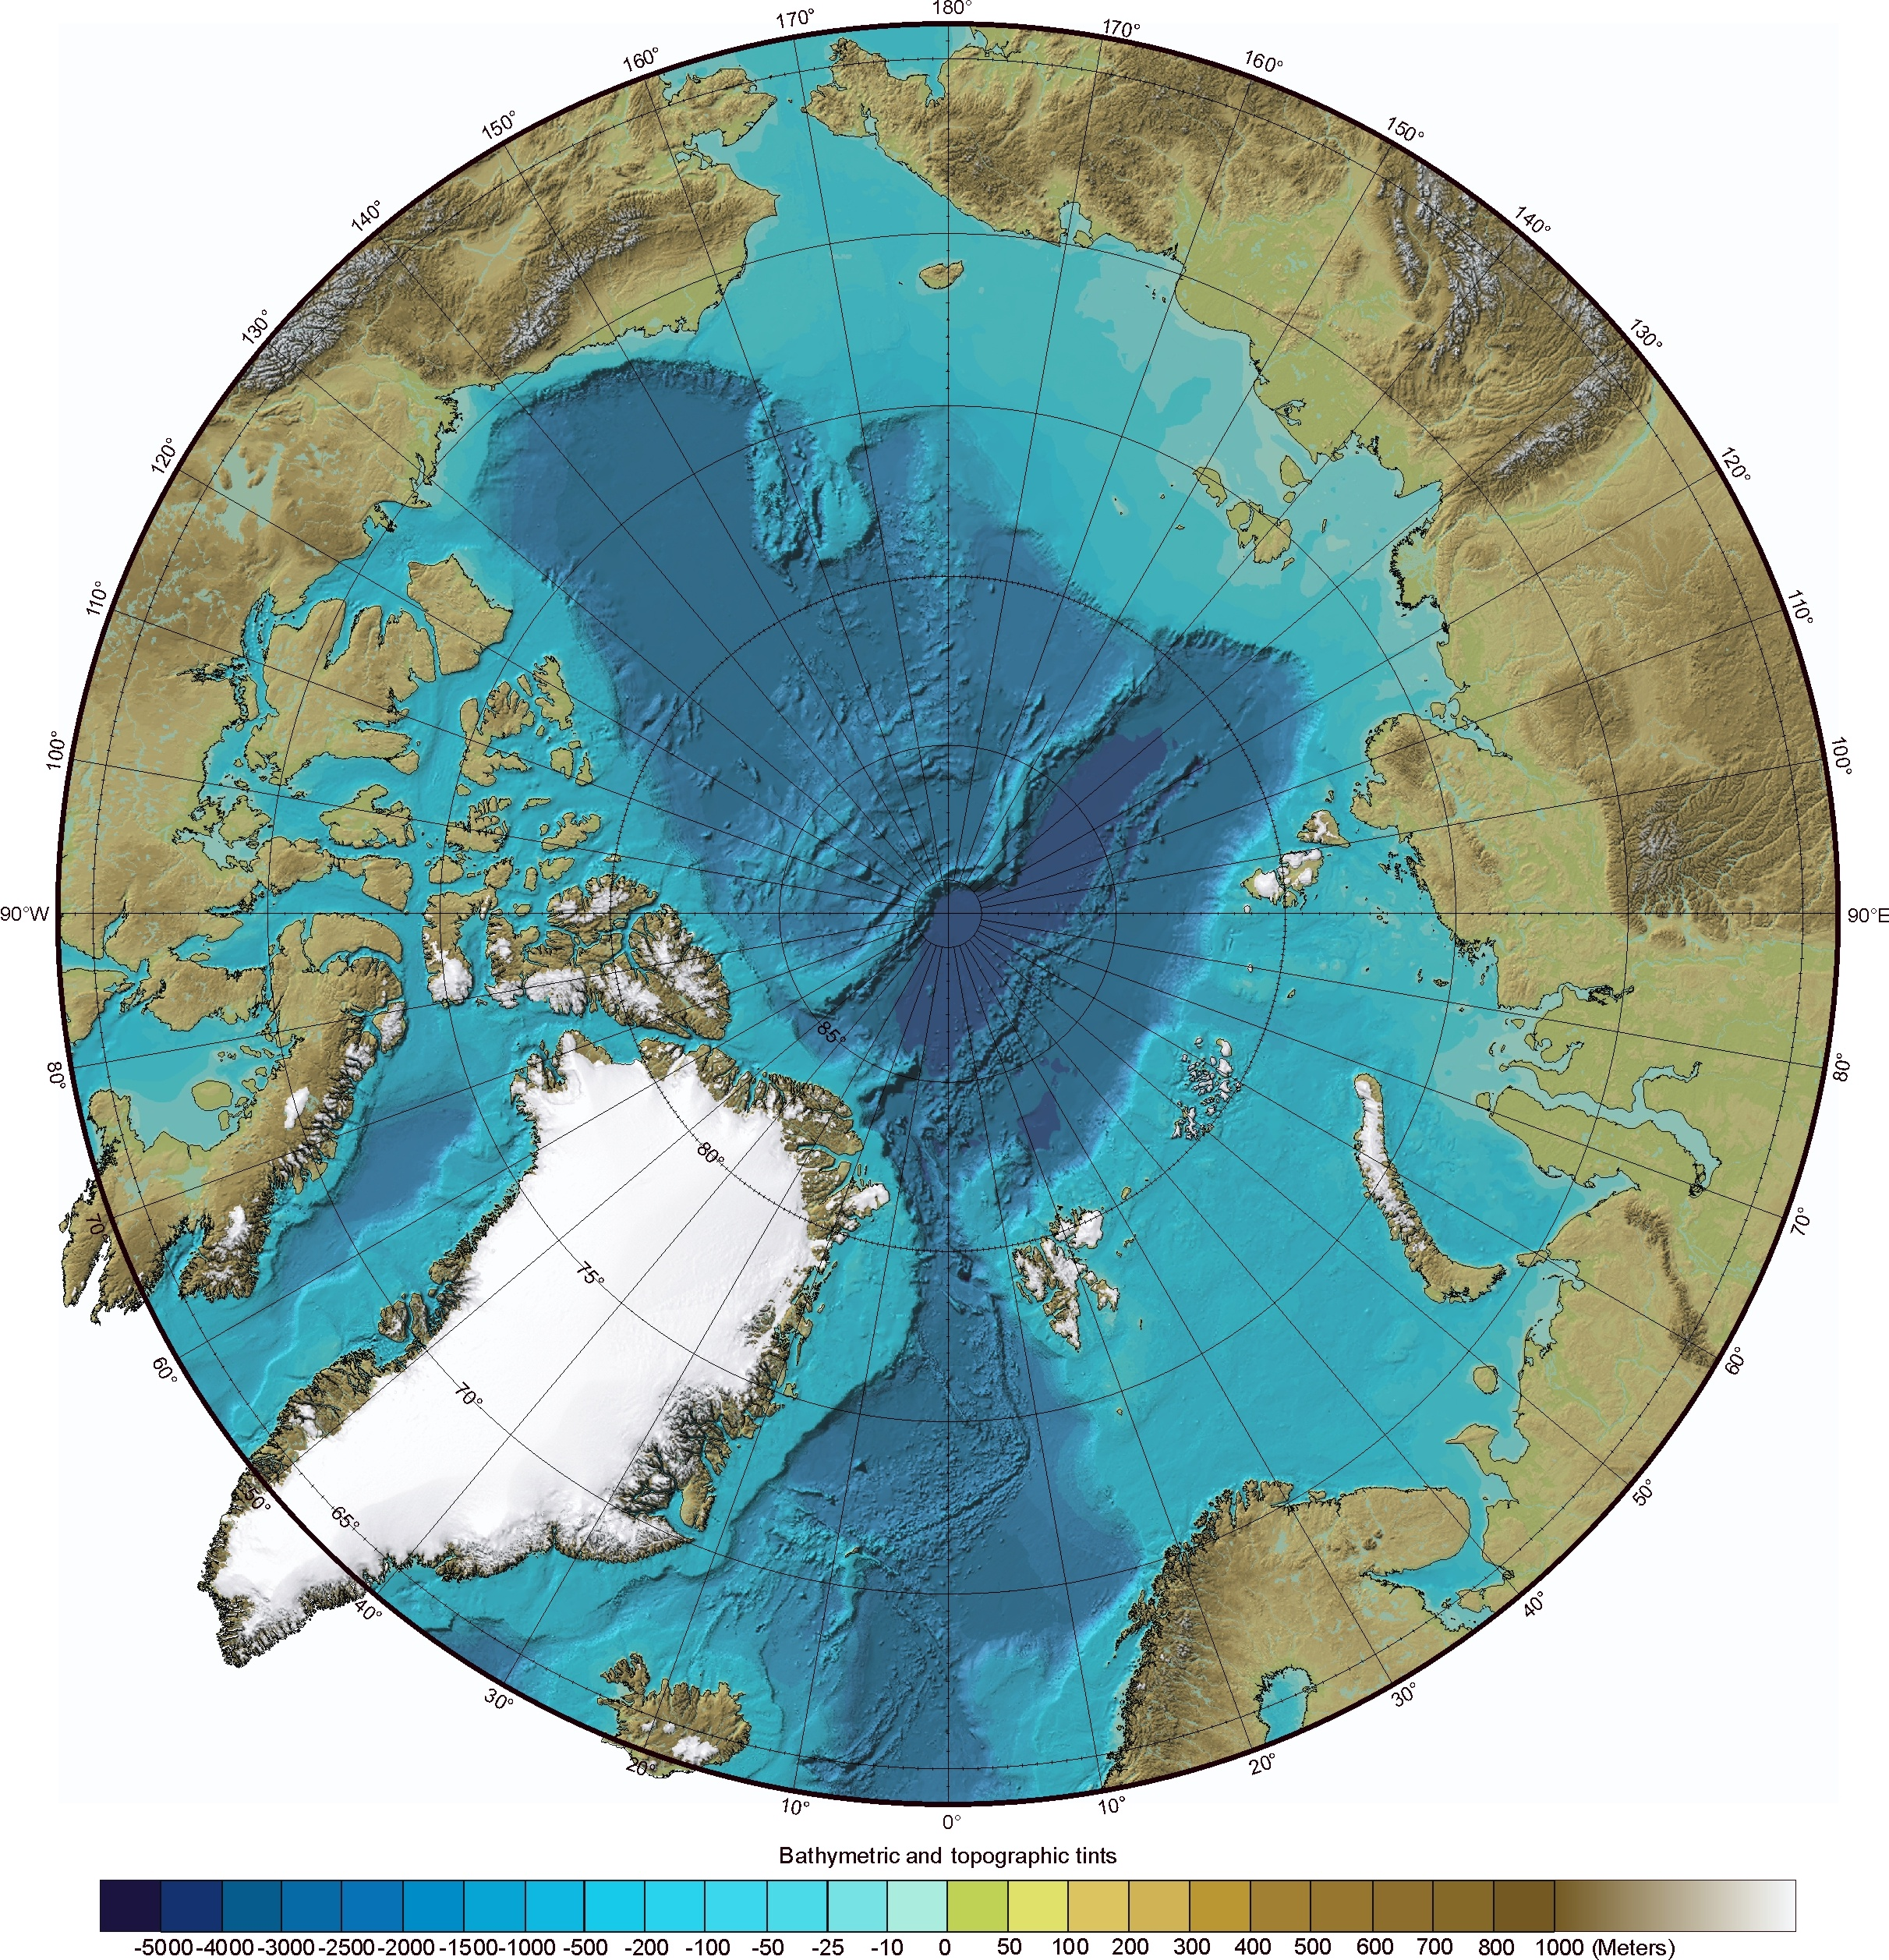
Canada, USA
JOIS/AON-BGOS (Williams/Proshutinsky, Louis)
LIA-MPA (Michel, Louis )
Davis Strait (Lee/Azetsu-Scott, Armstrong)
Japan, Mirai
Korea, ARAON
USA?, Healy
China, Xuelong?
Russia, Barents,?
Sweden, Oden
Norway, GO Sars (IMR)
KPH (Nansen Legacy) 2021
UK, highlight topic

Slide 2
The Norwegian Contribution
GO Sars
Crown Prince Haakon

Slide 3
The Norwegian Contribution
The Barents Sea Ecosystem Survey (IMR-PINRO)
The Fugløya-Bjørnøya transect (seven stations)
---------
Main objective of the network:
1. Describe water mass distribution and properties
2. Document ocean climate variability as part of long time series
3. Relate ocean climate variability to variation in recruitment, growth, condition and size of commercial fish stocks Observations are taken by IMR from research vessels.
The programme is carried out in cooperation with Russia (PINRO) coordinated under the Joint Norway-Russia Fisheries Commission. The current meter moorings are shifted once a year.

Slide 4
The Norwegian Contribution

