Slide 1
STATUS on SAS activities in Denmark since October 2018
Karen Edelvang
Head of section of Oceans and Arctic

Slide 2
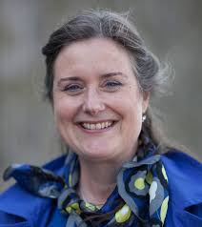
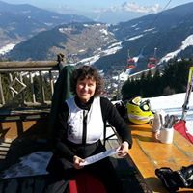
Danish members of the SAS steering committee
Member: Karen Edelvang, head of section of Oceans and Arctic, DTU Aqua, Danish Technical University
Alternate: Lise Lotte Sørensen, senior scientist, Arctic Research Centre, Aarhus University

Slide 3
Overview of current known Danish activities
DTU Aqua is partner in EFICA Consortium (The European Fisheries Inventory in the Central Arctic Ocean), linked to the MOSAIC
Framstrædet: - Aarhus University is working with Norwegians; and DTU Aqua with Norwegian Polar Institute. An application to ARICE for 2021 shiptime is planned.
SAS has been promoted again at our national yearly Arctic meeting at Hindsgavl in April 2019
SAS is included in ISAAFFIK which is the Danish database for Arctic research and infrastructure https://www.isaaffik.org/
SAS has been mentioned in the Danish Center for Marine Research 2020 call with deadline 1/4 2019
DTU Aqua is part of ARICE, which is part of the EU Arctic cluster offering shiptime on Arctic going ships and has SAS in here https://www.arice.eu/
Aarhus University is part of a GLACE application https://polar.epfl.ch/page-156957-en.html

Slide 4
Overview of DTU Aqua activities
DTU Aqua does not have any Danish led research expeditions planned so far. We collaborate with the Norwegian Polar Institute in the Fram Strait every year (also during SAS) as mentioned in the above slide. This is with R/V Kronprins Håkon. Here we contribute to measuring water chemistry (inorganic nutrients, dissolved organic carbon and CDOM). In 2019 and 2020 we will also be collecting water for anthropogenic radio-isotopes.
We are planning an application to ARICE with call deadline 3 July (see later slide) to expand/extend the cruise in 2020 and 2021 to allow for additional water sampling (wire time for extra profiles). This includes phytoplankton and bacteria measurements and DOM degradation experiments.
With respect to Danish Center of Marine Science (a virtual national center for ship time funding with secretariat at DTU Aqua), we are aware of plans for coastal work in Greenlandic waters in 2020. The deadline for ship time funding for use in 2021 is, 1st of April 2020. So there may still arise opportunities for Danish Arctic sampling initiatives in 2021. We are welcoming other interested for joining the proposal.

Slide 5
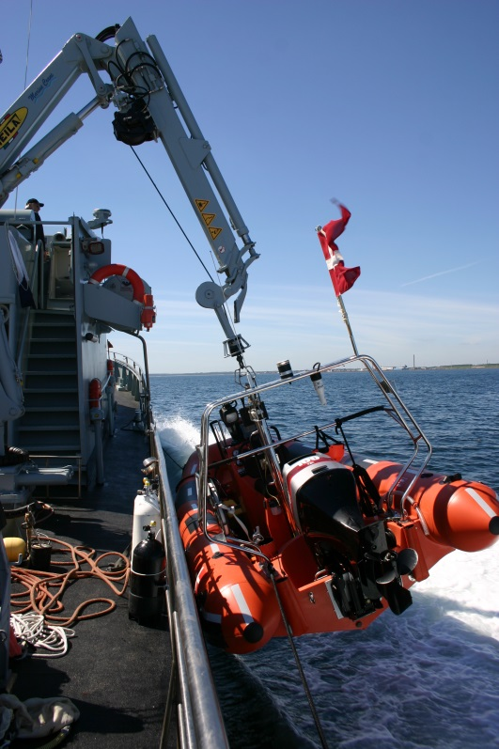
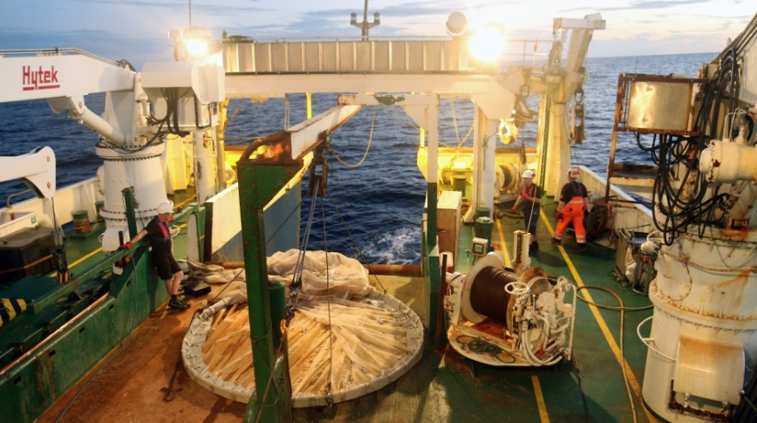
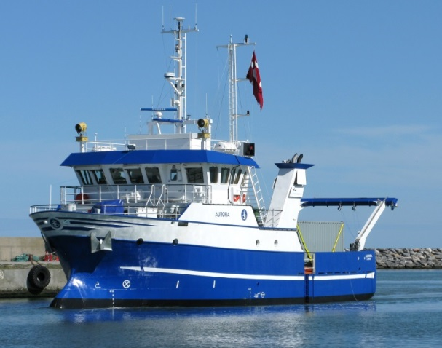
Danish Centre for Marine Research (DCH) Opportunities for Danish marine science
Sampling opportunities in DK waters with the Marine Home Guard (Marinehjemmeværnet)
Ship charter funding for oceanographic research
Use of Navy vessels as oceanographic research platform
http://www.danskhavforskning.net/service/english

Slide 6
ARICE
ARICE Call for proposals:
Next call open till 3 July 2019
Keep tuned! www.arice.eu

Slide 7
Access
ARICE2019 Call for Ship-time proposals - NOW OPEN!!
We are now inviting you to submit ship-time proposals requesting access to
MSV Fennica, RV Kronprins Haakon and IB Oden
to carry out ship-based research activities within any field of marine science in the Arctic Ocean
(restrictions may apply, check the specific access conditions for each vessel and vessel descriptions)
This call will remain open until the Wednesday 3rd of July 2019, 12:00 CEST.
Submit your proposal here: https://ptoutline.eu/app/arice2019
Download the call documentation, including instructions and templates here
TIP!!: ARICE webinars on "Proposal writing" and "Cruise preparation and risk reduction" can be accessed here

