Slide 1
Potential contribution of CHINARE to SAS
Jianfeng HE
Polar Research Institute of China

Slide 2
Platform_R/V XUELONG 2
A new icebreaker for polar ocean investigation

Slide 3
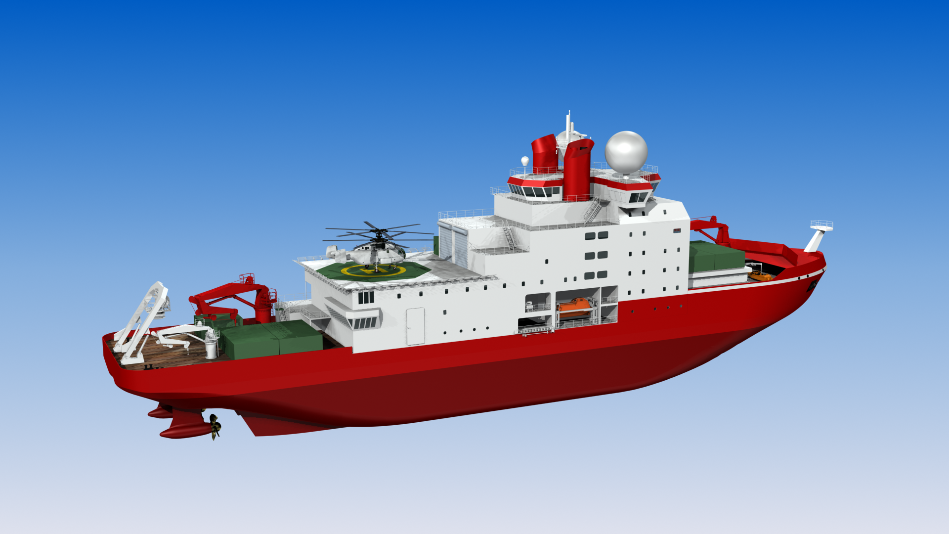
Displacement of 14,000 tons, 20,000 nm endurance, self-sustaining for 60 days
Ice breaking, double acting (forward and backward), 1.5m sea ice plus 0.2m snow, at 2 to 3 knots.
90 berths (41 crews)
Hydrographic, chemical , biological, geological and geophysical investigations

Slide 4
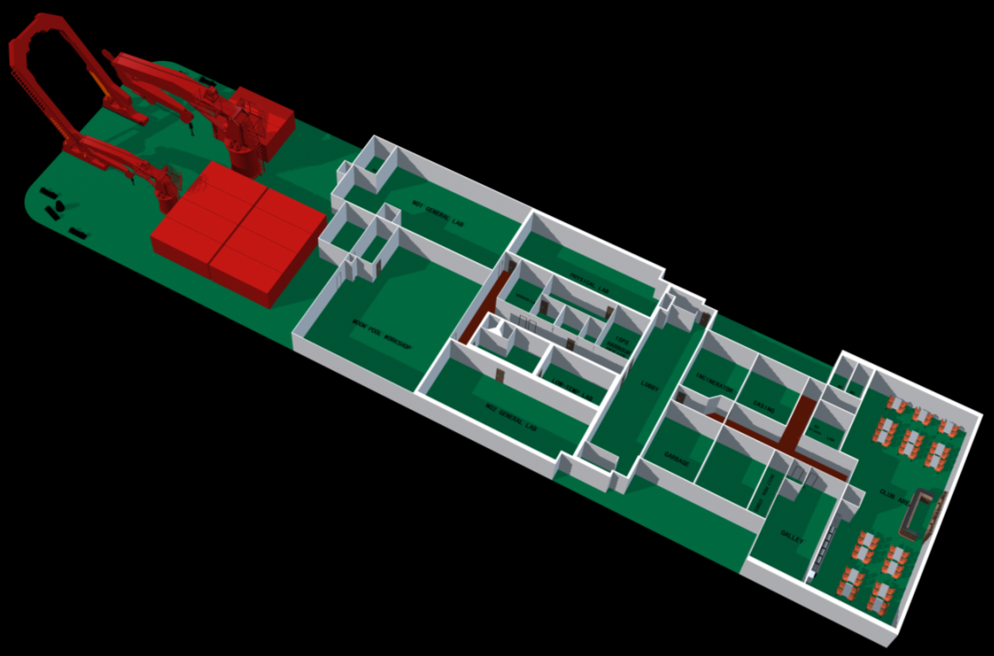
Labs and stern deck (main deck)
Wet lab No.1（120M²）
Dry Lab（70M2）
Sample storage（16M2）
Low-temperature
Lab（21M2）
Stern deck（~600M2）
Baltic-Moonpool workshop（160M2）
with 3.2 m* 3.2 m moopool
Wet Lab No.2（90M2）
主甲板实验室区域和尾甲板作业区 (Deck 4)

Slide 5
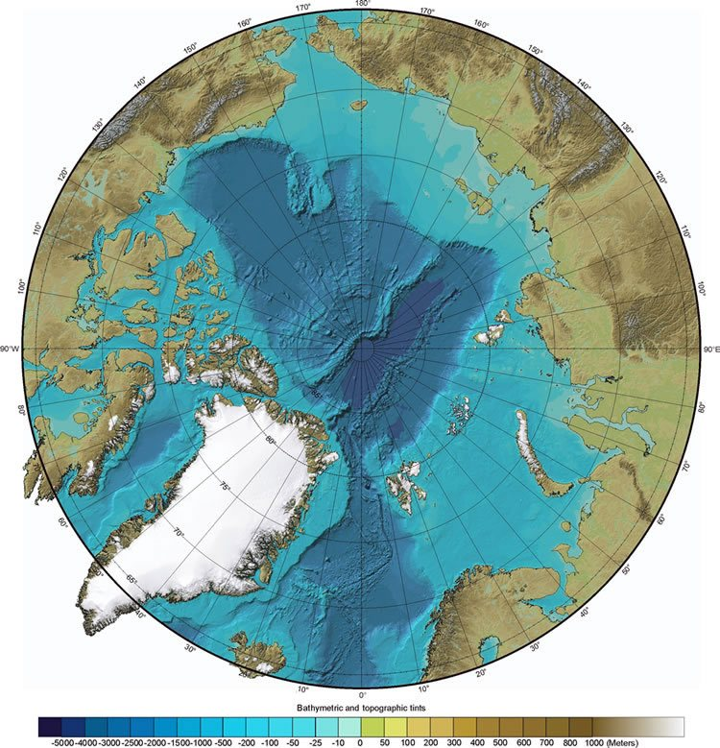
Cruise plan (2020/21)
Aug.: MOSAiC cruise
Sept.: Central cruise (SAS)
Red curve: possible cruise track
Yellow box: ice buoy deployment area

Slide 6
Equipment and samples
Equipment:
AWS
ADCP
OceanPack
CTD/XBT/XCTD
Biological trawl nets
Aerosol sampler
Ice buoys
……
Samples for analysis:
Aerosol
Sea water
Biological samples
Ice cores
……
Underway observation parameters:
Air temperature, ……
Hg in the atmosphere
Sea ice coverage, thickness
Subsurface water T/S/Nutrients/Chlorophyll/pCO2
Water current
……

Slide 7
Thanks!

