Slide 1
CommuniTea
Recognizing and Addressing Burnout at WHOI
Workplace Climate Committee

Slide 2
WHOI Land Acknowledgement
We collectively acknowledge that Woods Hole Oceanographic Institution is located on the unceded ancestral and contemporary land of the Wampanoag peoples. We acknowledge the Mashpee, Aquinnah, Herring Pond, and Assonet Wampanoag Tribes as the original stewards and protectors of this land and surrounding waters. We recognize the perpetuated detrimental effects that systemic governmental oppressions have had on indigenous communities as a result of colonization. By offering this land acknowledgement we accept our responsibility to understand this history, invest in reconciliation, and build accountable partnerships with these communities.
Notes:
This land acknowledgement was created with input from elders of the Mashpee Wampanoag Tribe.
While it is not compulsory, please feel free to use this text in the classroom, on your syllabus or when introducing events or research presentations on the WHOI campus, and invite your audience to learn more about the Wampanoag Nations today. More information can be found at the links below:
Mashpee Wampanoag Tribe (mashpeewampanoagtribe-nsn.gov)
Wampanoag Tribe of Gay Head (Aquinnah) (wampanoagtribe-nsn.gov)
Our History – Herring Pond Wampanoag Tribe (herringpondtribe.org)

Slide 3
CommuniTea Guidelines
Recognizing and Addressing Burnout at WHOI

Slide 4
Be respectful of the others in the room.
  Be aware of your speaking volume.
  Use others’ correct pronouns and names. If you make a mistake, correct yourself.
  Refrain from using offensive language.
Discuss ideas, not people. Please, no personal attacks.
Do not use names or personal identifiers when talking about past experiences.
Try to give everyone at your table the opportunity to speak.
When you share what you learn here with coworkers and friends, please respect everyone’s privacy and avoid using personal identifiers.

Slide 5
Recognizing and Addressing Burnout at WHOI
OUTLINE
Definition of Burnout
Signs and Symptoms
Burnout Causes
Breakout #1 - followed by reporting
Overcoming Burnout
Breakout #2 – followed by reporting

Slide 6
What is Burnout?
• World Health Organization: "a syndrome conceptualized as resulting from chronic workplace stress that has not been successfully managed.”
• WebMD: “Burnout is an ongoing state of feeling overwhelmed, fatigued, and emotionally drained due to consistent stress in your work, family, or social life.”
The condition isn’t medically diagnosed. But burnout can affect your physical and mental health if you don’t acknowledge or treat it.

Slide 7
What is Burnout?
Burnout can often be confused with stress or depression. Some differences are that while stress may lead to increased motivation and productivity, burnout is associated with lack of motivation and decreased productivity. Burnout can also look like depression, but a key difference is that you can ease burnout with rest or time off, whereas depression is a medical illness requiring therapy or medication.

Slide 8
Signs and Symptoms of Burnout
Exhaustion: You may feel drained and unable emotionally to deal with problems around you, both professional and personal. You may feel low and experience extreme tiredness, leaving you without energy. These symptoms can show up as physical pain, and stomach (or bowel) problems.
Alienation from activities: Look out for signs of cynicism and frustration toward work and colleagues. You may start to distance yourself emotionally and feel numb about your work and environment.

Slide 9
Signs and Symptoms of Burnout
Reduced performance: This can occur at work or home (when caring for family members) because you have no energy left for everyday tasks. Burnout makes it hard to concentrate, handle responsibilities, or be creative.
Mental burnout symptoms: You may feel self-doubt, helplessness, defeat, and failure. You may feel that you are on your own, lose your sense of purpose, and feel increasingly cynical, dissatisfied, and incapable.

Slide 10
Signs and Symptoms of Burnout
Physical burnout symptoms: You may feel greatly fatigued and without energy. You may get sick often, have body aches and recurring headaches, lose your appetite, or experience insomnia.

Slide 11
What Causes Burnout?
• Unmanageable workloads
• Unfair treatment at work
• Confusing work responsibilities
• Lack of communication or support from managers
• Immense deadline pressure
• Too much work, not enough time to rest (downtime)

Slide 12
What Causes Burnout?
• A feeling that work or life is out of your control
• Feeling unrecognized or unrewarded
• Work or responsibilities that feel too demanding
• Boring or routine work, or chaotic or high-stress work
• Taking on too much without asking for help
• Lack of sleep

Slide 13
What Causes Burnout?
• Few supportive or meaningful relationships
• Personality traits such as perfectionism, pessimism, and a need for control

Slide 14
Breakout # 1
• How do you recognize burnout in yourself?
• How do you recognize burnout in others in your group?

Slide 15
How to Overcome Burnout
• Know the problem. Realizing you have burnout is the first step toward recovery.
• Find support: The support of trusted coworkers, friends, and family is important. Their support can help you deal with the stressors of your job. If possible, talk with your supervisor about how you're feeling and discuss a more manageable workload. Communication is important for creating a healthy work environment.
• Reevaluate your attitude about work. You can't always change your job, but you can change how you feel about it. Find something to value in your work and create balance in your life. Take a vacation or extended leave to remove yourself from work stress.

Slide 16
How to Overcome Burnout
• Engage socially. Talk to or have lunch with colleagues. Avoid interacting with negative people. Find a volunteer effort or support group where you can be around and talk to people who enjoy the same activities as you.
• Be mindful: This gets you to focus on yourself internally, and know how you’re feeling in the moment. Slow down and reconsider your goals for life and work. Practice saying no. Disconnect from technology each day or pick up a new hobby or activity. Mindfulness can help you identify when you’re feeling overwhelmed and let you take stock of your emotional well-being. It can also help you manage the challenges of life and work.

Slide 17
How to Overcome Burnout
• Prioritize your health. Get more sleep, eat better, and exercise - whatever it takes to get back on track. Exercise helps lift your mood, even a 10-minute walk can boost your mood for several hours. Limit sugary and carbohydrate-rich foods that can lead to a dip in energy and mood. Avoid caffeine and nicotine, two stimulants that can affect your mood. Drink alcohol moderately.

Slide 18
How to Overcome Burnout
Leadership Goals
• Make wellbeing part of work culture.
• Equip managers to recognize and reduce worker burnout.
• Design the employee experience to prevent burnout from the start.

Slide 19
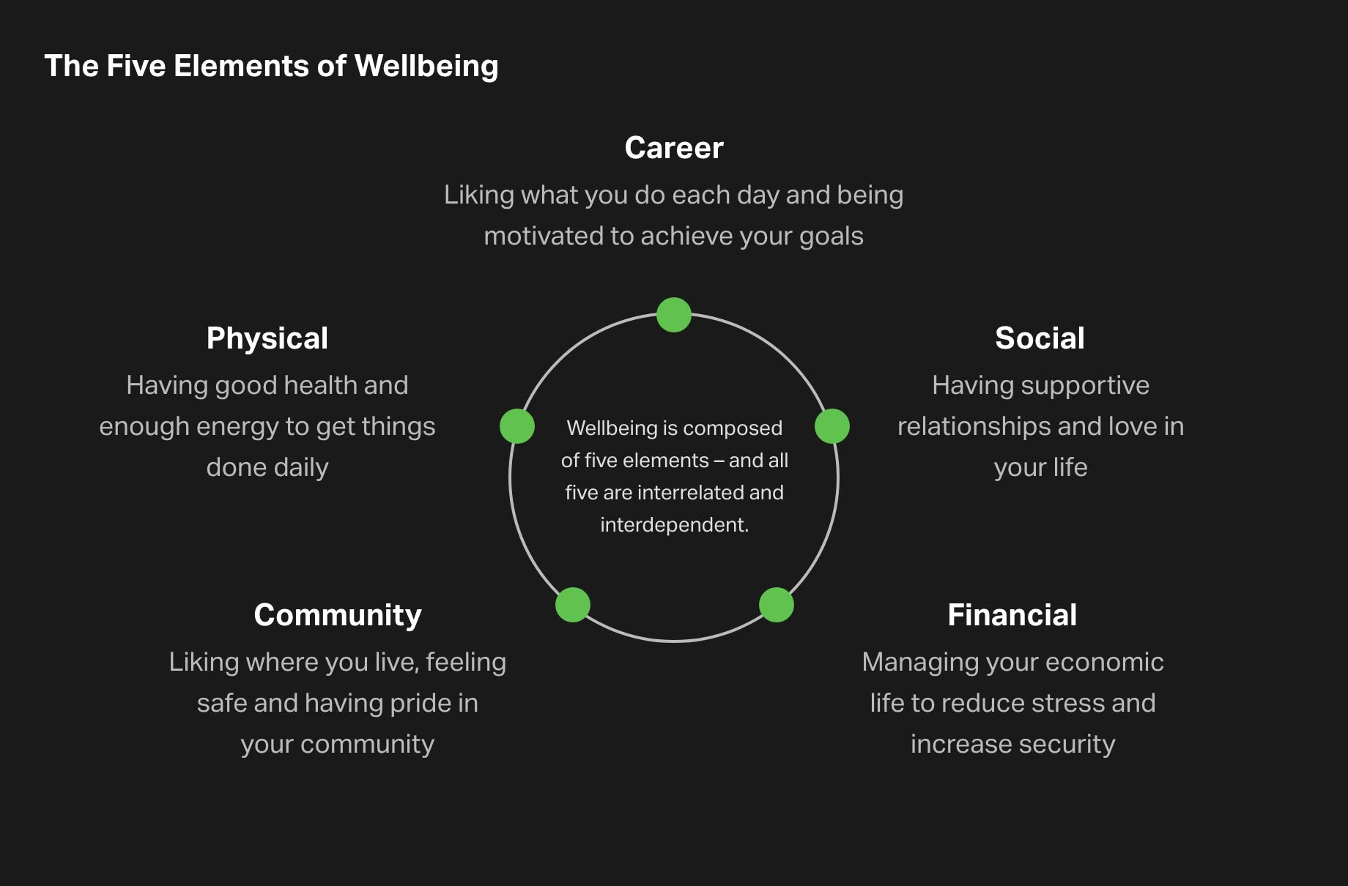
The Five Elements of Wellbeing
Career
Liking what you do each day and being motivated to achieve your goals
Physial
Having good health and enough energy to get things done daily
Wellbeing is composed of five elements - and all five are interrelated and interdependent.
Social
Having supportive relationships and love in your life
Community
Liking where you live, feeling safe and having pride in your community
Financial
Managing your economic life to reduce stress and increase security
Liking what you do each day and being motivated to achieve your goals
Having good health and enough energy to get things done each day
Having supportive relationships at work and at home
Liking where you work, feeling safe and having pride in your community
Managing your economic life to reduce stress and increase security

Slide 20
Breakout # 2
• What do you do to mitigate burnout in yourself and others in your group?
• What can WHOI do to help address burnout?

Slide 21
Recognizing and Addressing Burnout at WHOI
THANK YOU
AND
BE WELL!

