Slide 1
Do we know K_{d}? “The slime problem”
Challenge: Phoebe’s data shows different K_{d} for different mineral phases
But we know that most particles are covered by organics
Some key questions:
- what is rate of K_{on} and K_{off} for metals, and for organics to mineral phases
- how constant are organic coatings with location and particle type?
- is mass the best thing to use to characterise scavenging? Should we use surface area and surface charge instead?
- are lab surface area measurements relevant to the field?
- how much variation is there in K_{d} and organic coatings with latitude, productivity, O₂ levels, etc.?
- Mn and Fe oxyhydroxides have similar surface area but very different K_{d}; different organic coating?
Some good news, though:
- just adding Mn-oxyhydroxides with high K_{d} is a step forward (and realised in PISCES now)

Slide 2
A model for metals: ligands, colloids, aggregation/disagg.

Slide 3
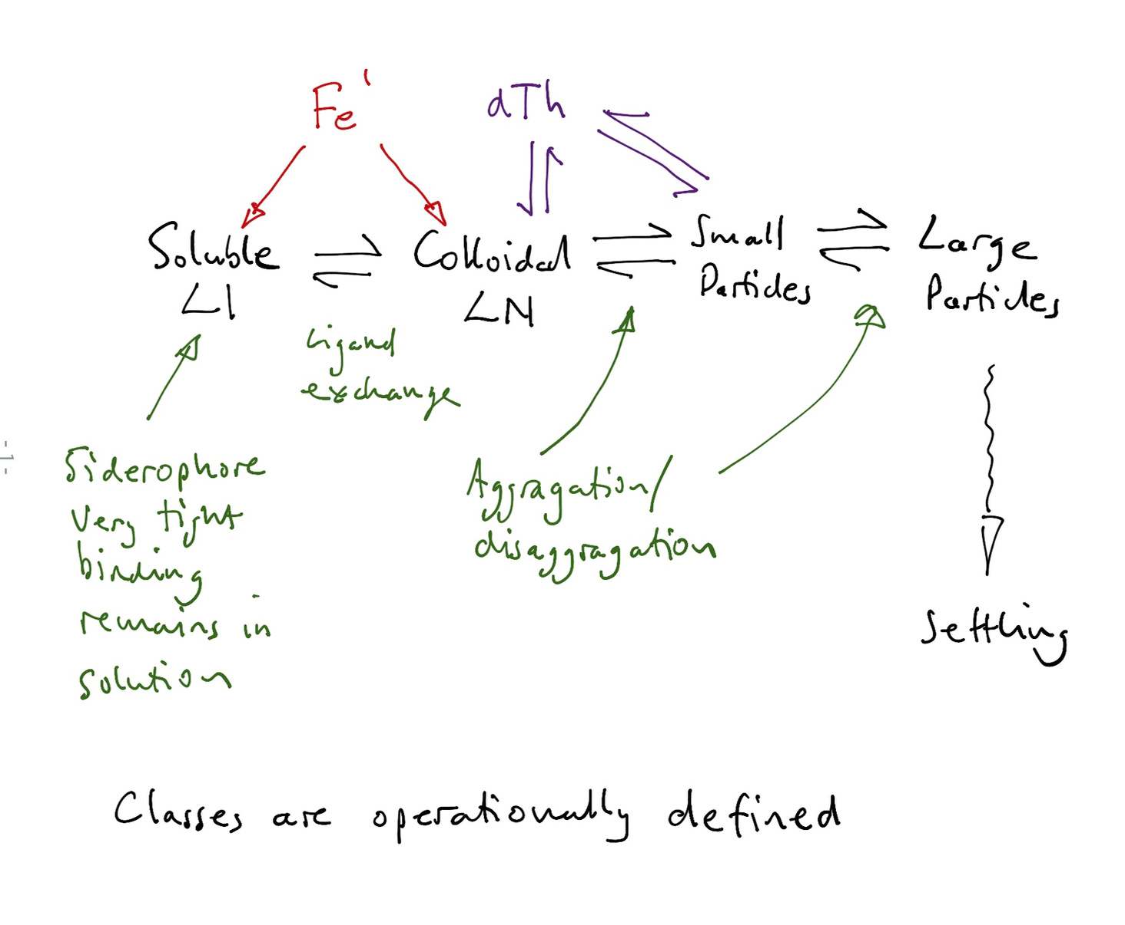
A model for metals: ligands, colloids, aggregation/disagg.

Slide 4
Some immediate products:
Th isotopes useful for aggregation/disaggregation; extend this to colloid-small particle (Jess/Tom/Paul)
Provocative review of organic complexation, exchange, and aggregation/disaggregation model (Kristen/Jess/Tim/Phoebe/…)
We are close to being able to model L1 field in ocean
If...
L1 field is modelled, and Th gives us particle dynamics… we have quantified major aspects of metal scavenging.

Slide 5
Nepheloid layers
They are very different from open ocean in terms of particle composition (as well as concentration)
Not all layers are the same (at all!)
Oxyhydroxides are important (and possibly predictable given overlying productivity flux)
Need to target some key locations with range of measurements

